Slide 1

Fastest growing Real Estate Markets
Alex Burch Abdurrahman Darvesh Sean Findley Rodney Kirkendoll serena leung Roderick Reynolds Jamie thorpe
Notes:
Alex

Slide 2
research question
Our client, a real estate developer, is interested in exploring these questions:
Which market had the highest recent growth in per square foot prices?
Which market had the least amount of growth?
Notes:
Alex
interested in figuring out which market to invest in that will have the highest growth potential. We will look at population growth over the course of five years, income, and poverty levels.

Slide 3
Hypothesis vs. alternative hypothesis
Null Hypothesis
Alternative Hypothesis
There is no relationship between population growth or income and price growth.
Cities that have the highest population growth will have the highest price growth potential.
Cities that have higher income levels correspond to real estate with higher prices.
Notes:
Abdurrahman

Slide 4
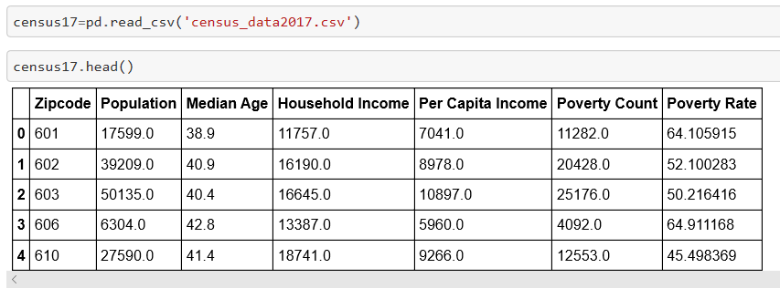
Coding approach & Data Munging
Datasets used:
US Census data (2012-2017) was pulled from Census API
Zillow data
Notes:
Rodney
Data points we pulled:
Zip codes
Population
Median Age
Household income
Per Capita Income
Poverty count
Poverty Rate
Statistics were then summarized for 2017

Slide 5
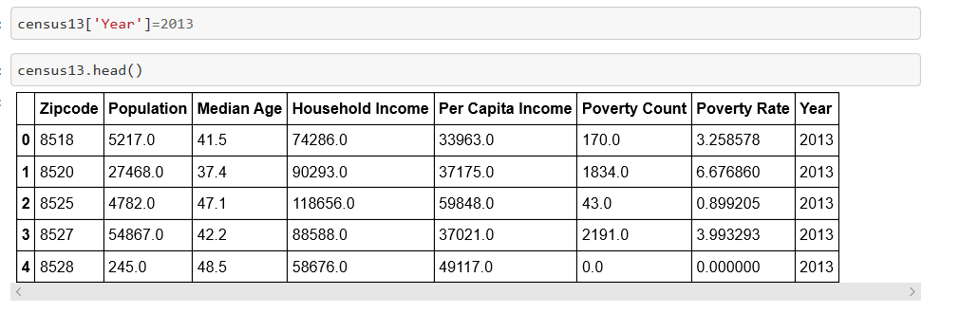
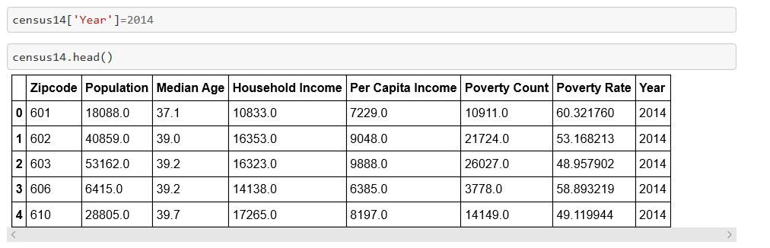
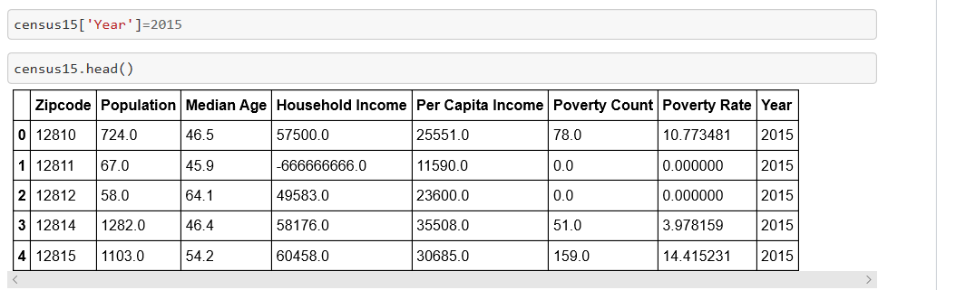
Additional data munging

Slide 6
Visualization approach
Explore population and income change over recent years.
Review change in price per square foot on a year-to-year basis to see which zip code had the highest percentage growth.
Notes:
Rodney
Our client can use the census data we pulled in the ETL project to look at population and income change over recent years.
Our client can also look at percentage change in income on a year-to-year basis to see which zip code had the highest percentage growth.

Slide 7
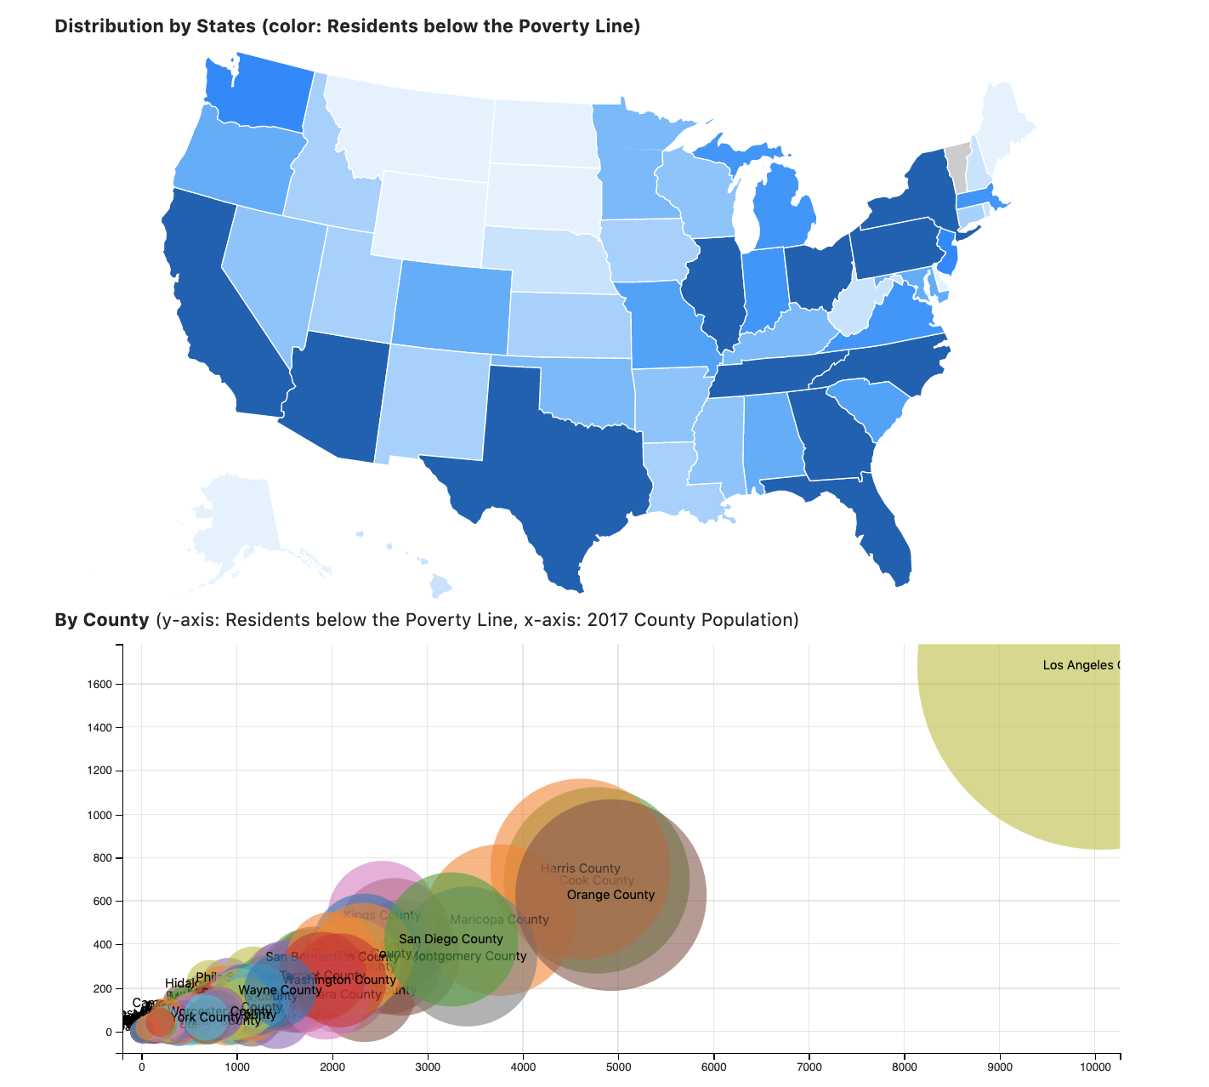
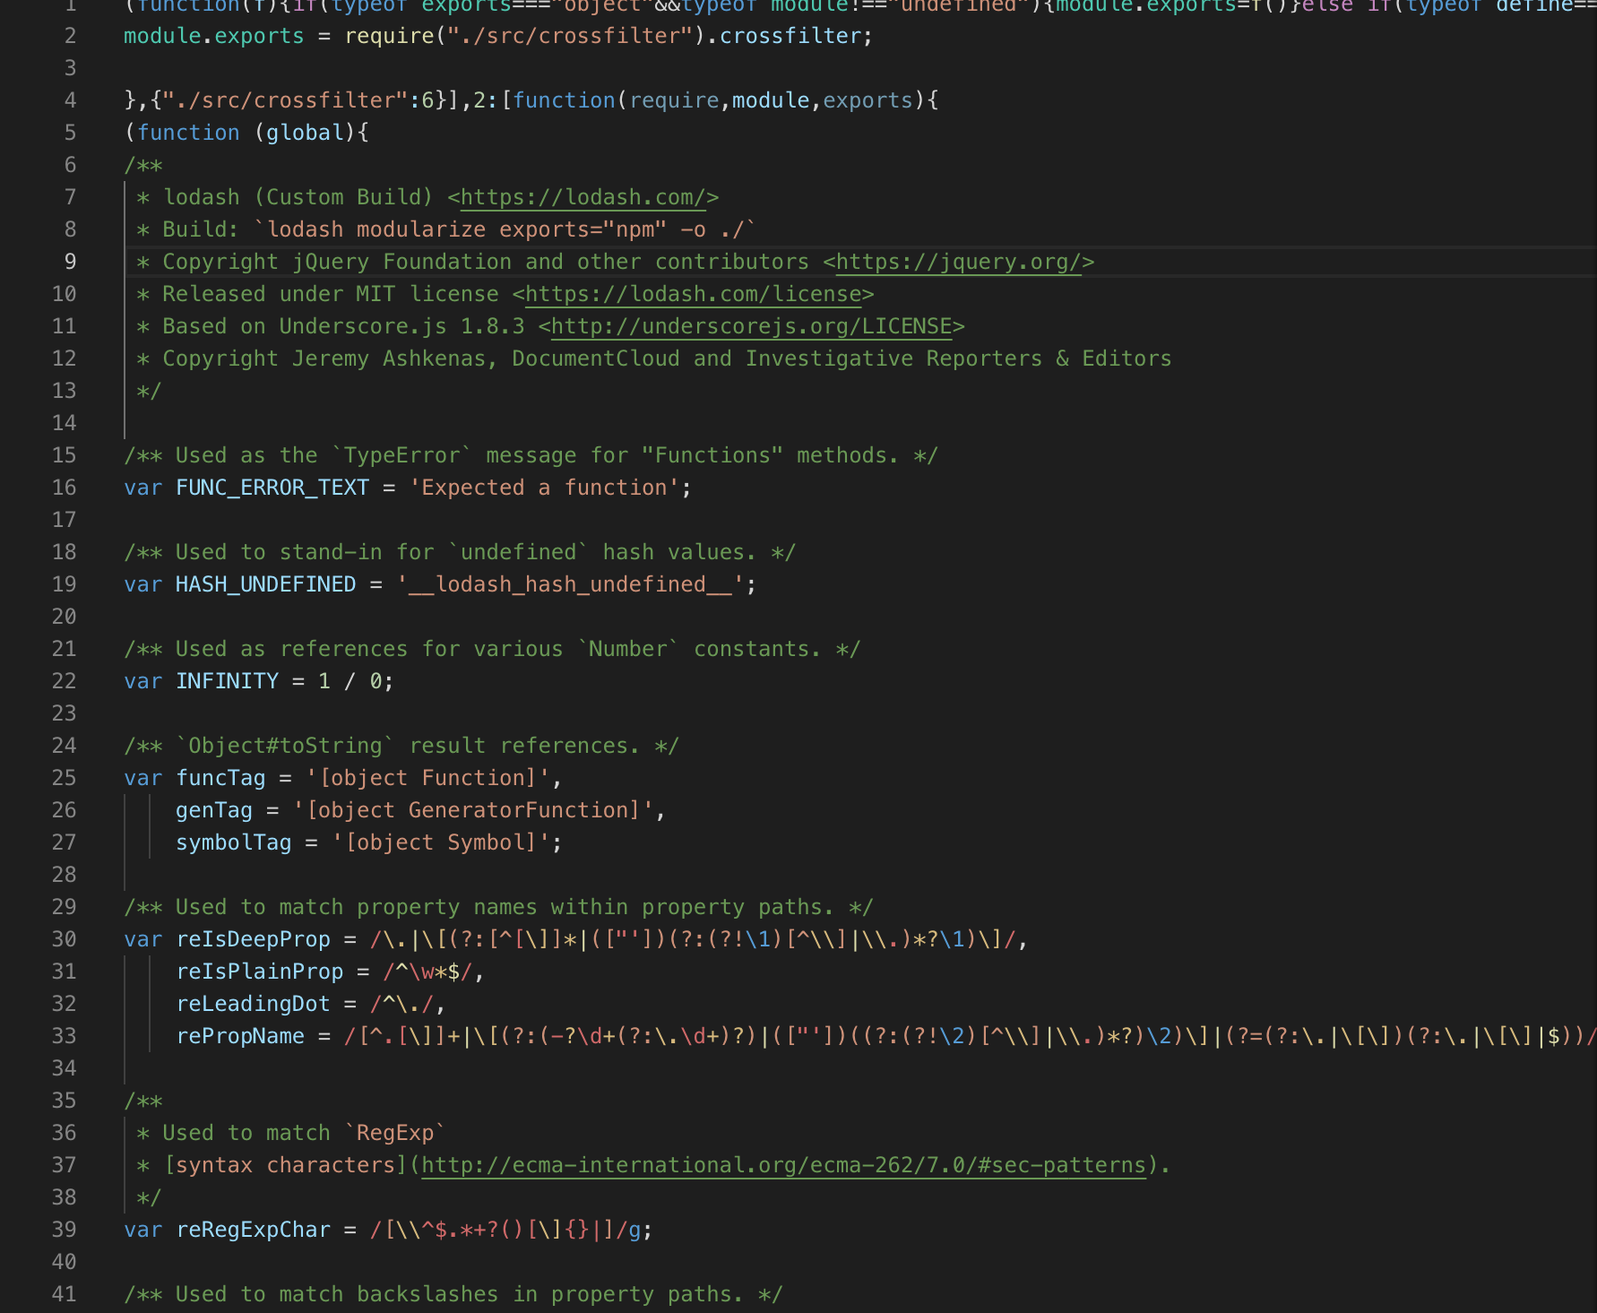
2017 Census data: Poverty vs. Population
Notes:
Sean
The Choropleth map at the state level that interacts with the bubble chart displaying the city and county with poverty count. The y-axis is an aggregate count.
Utilized GeoJSON Polygon, dc.js, Choropleth map, crossfilter.js…
We chose to focus on 2017 because it is the most recent year of census data we have.
Bubble chart shows # of residents below poverty level; x-axis shows county population.
Highest concentration of residents below poverty line are Los Angeles, New York, and Houston. Recommend counties with less poverty: Trinity, Yuba counties

Slide 8
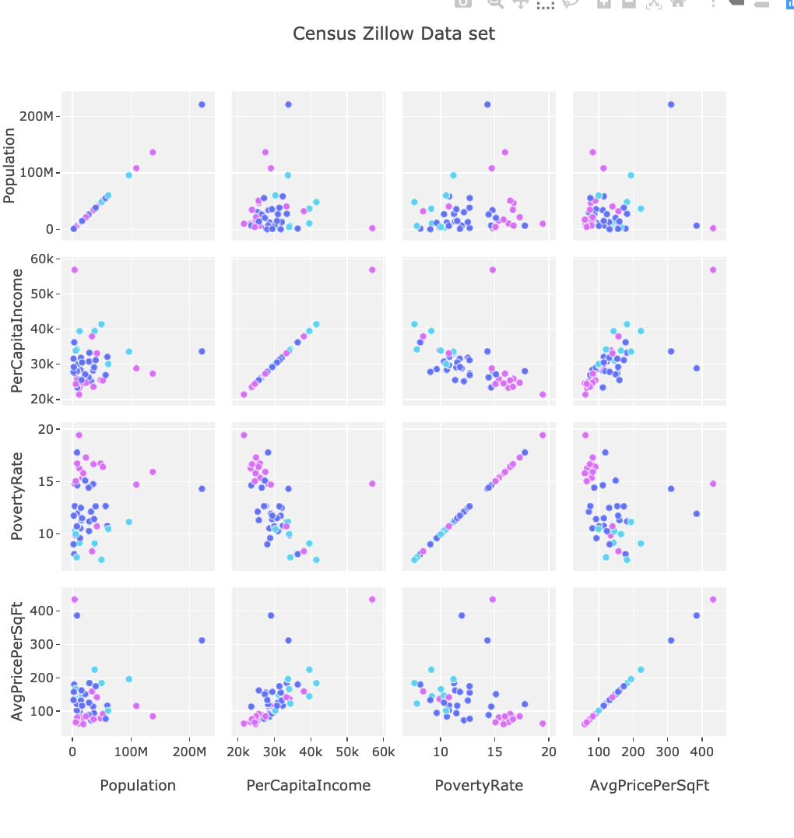
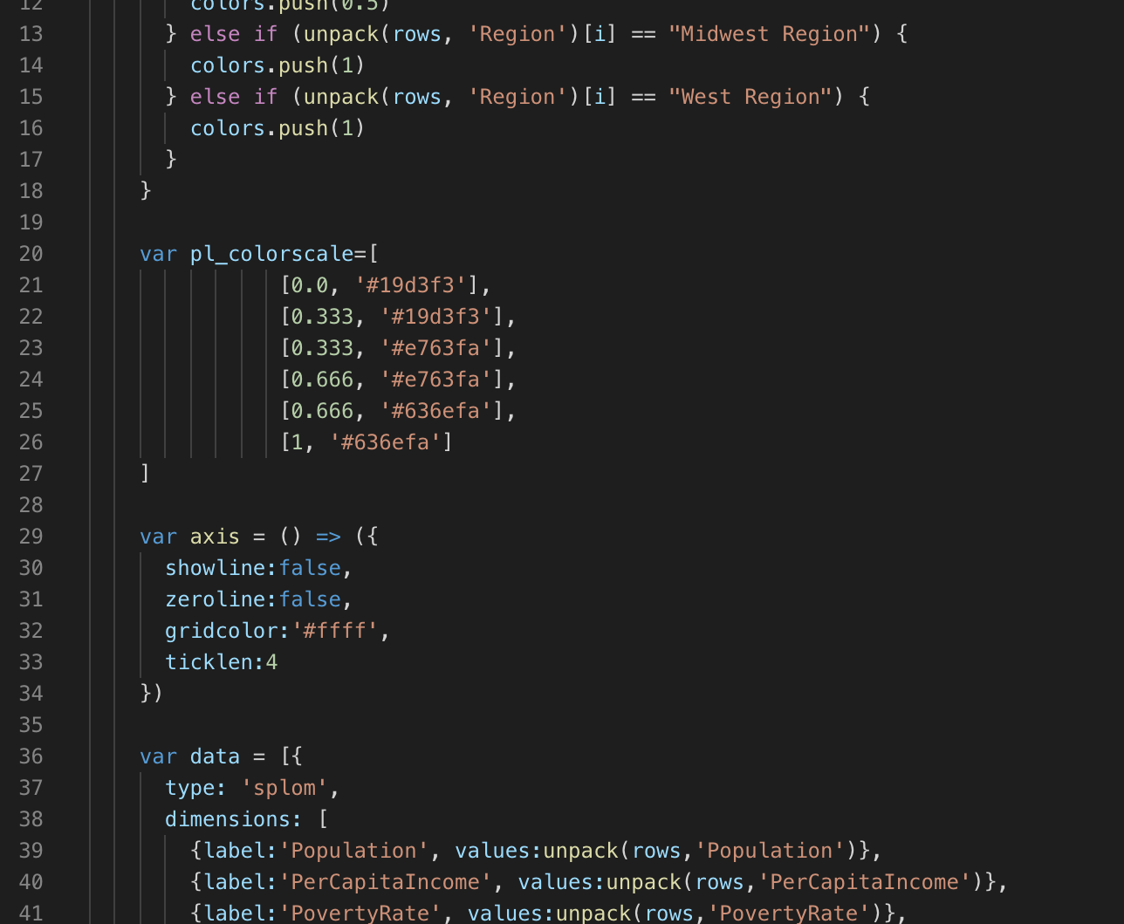
Census vs Zillow Data Correlations
Notes:
Serena
Shows the correlations against the average per square foot in each of the census variables
Utilized JS, D3, etc…
We looked at correlations between census variables and avg price per square foot: what we found is that income is most correlated

Slide 9
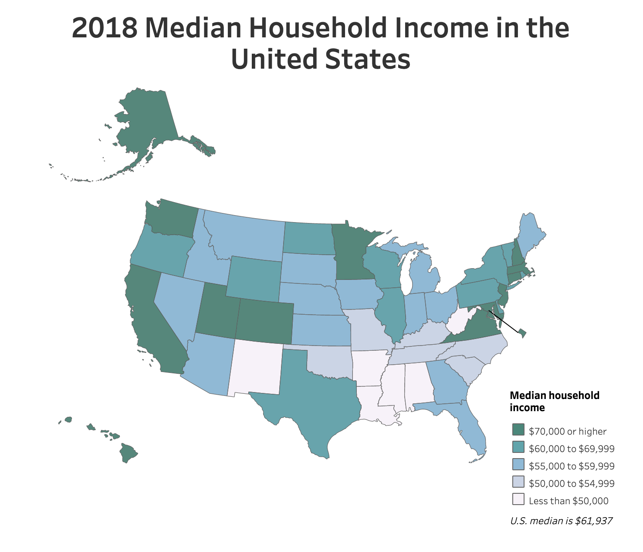
Median household income is highest in CA, WA, UT, CO, IL, northeast
Source: US Census Bureau. Median Household income By State: https://www.census.gov/library/visualizations/interactive/2018-median-household-income.html
Notes:
Serena

Slide 10
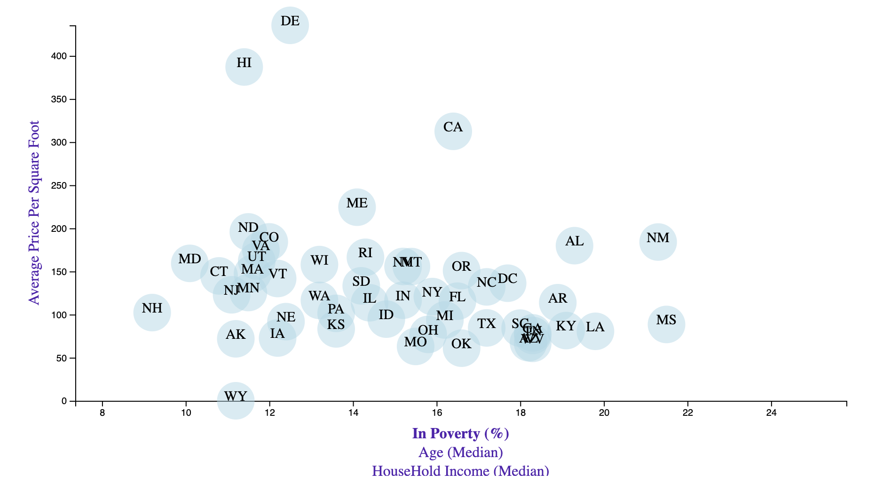
Correlations between Poverty, Age, HH Income & Avg Price
Notes:
Alex

Slide 11
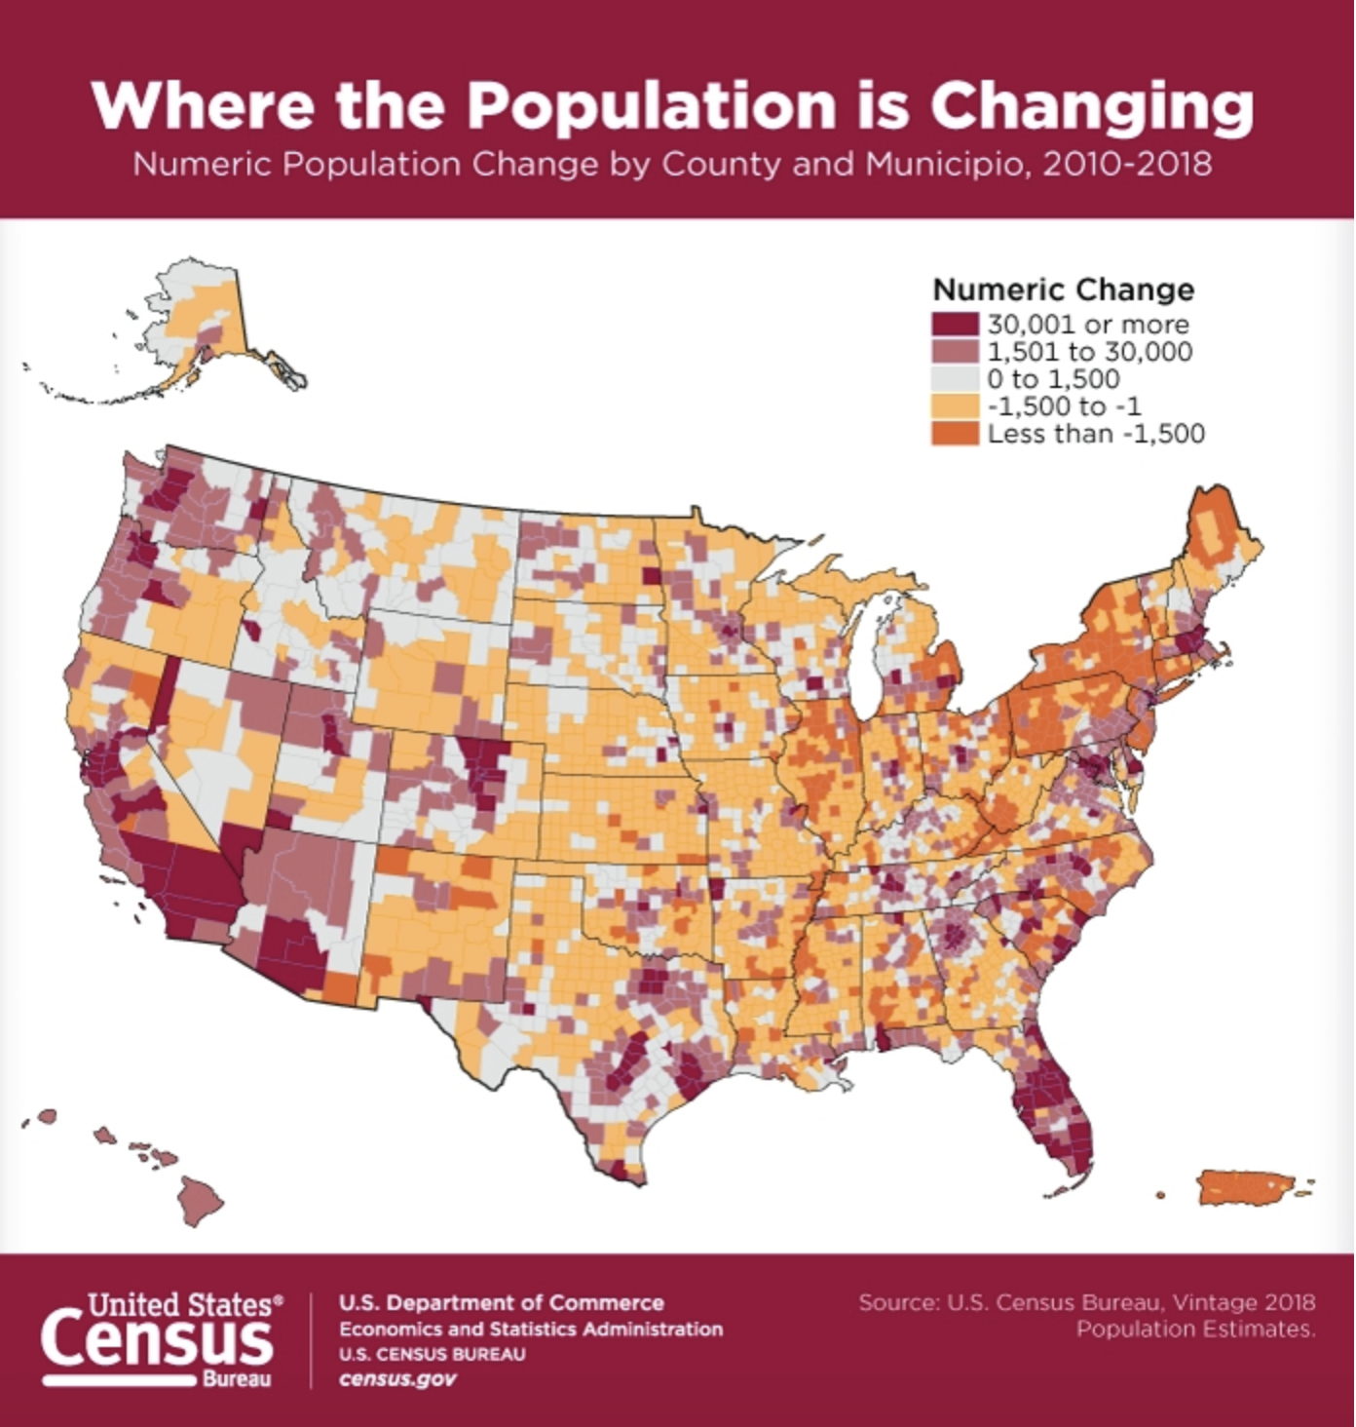
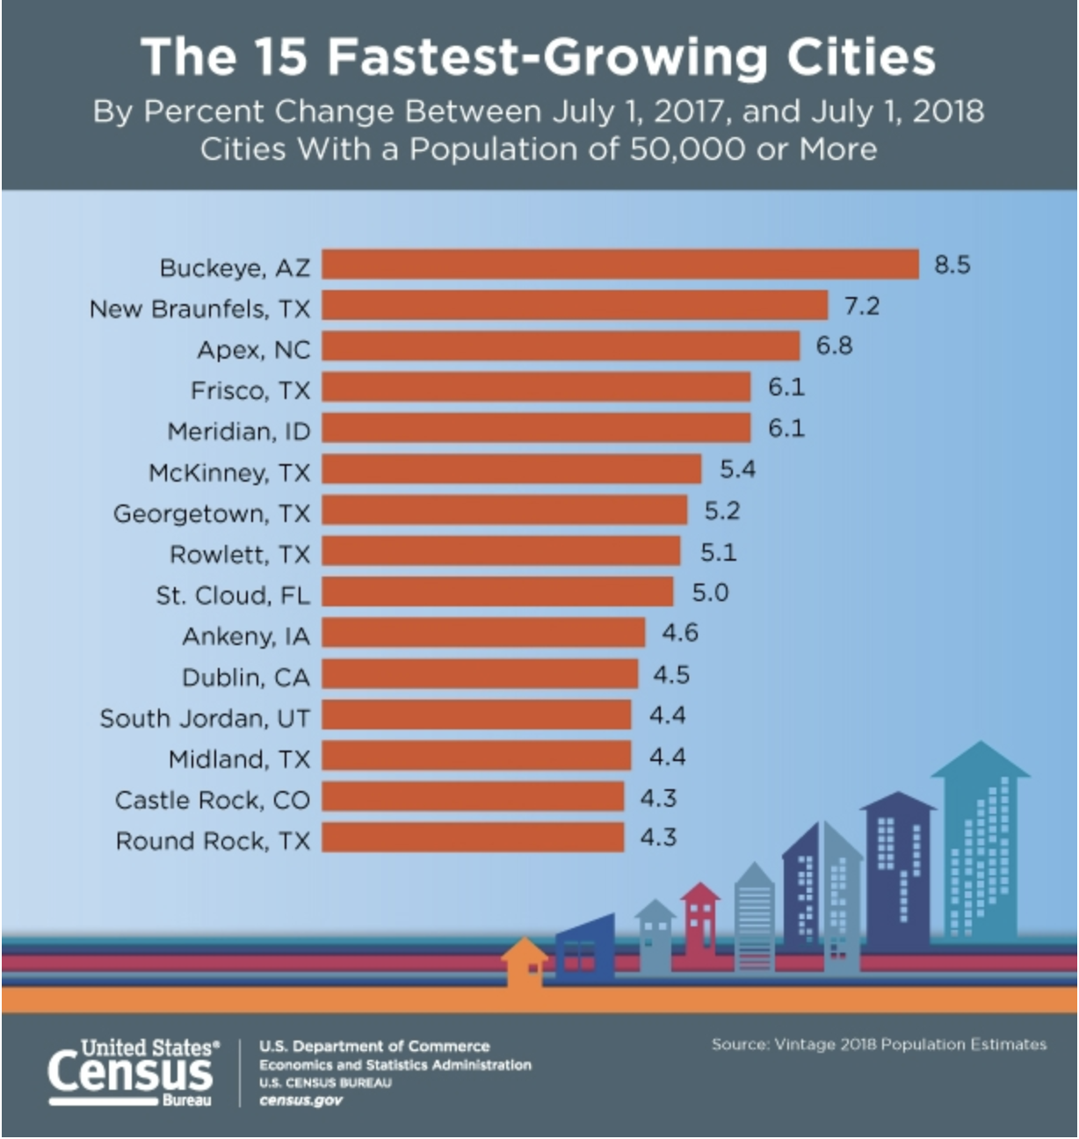
High Population Increases In Fl, WA, CA
Source: US Census Bureau. Fastest growing cities: https://www.census.gov/library/visualizations/2019/comm/15-fastest-growing-cities.html
Source: US Census Bureau. Population change by county: https://www.census.gov/library/visualizations/2019/comm/num-pop-change-county.html
Notes:
Alex
Increase in population in CA, FL, WA – higher population means more demand for housing

Slide 12
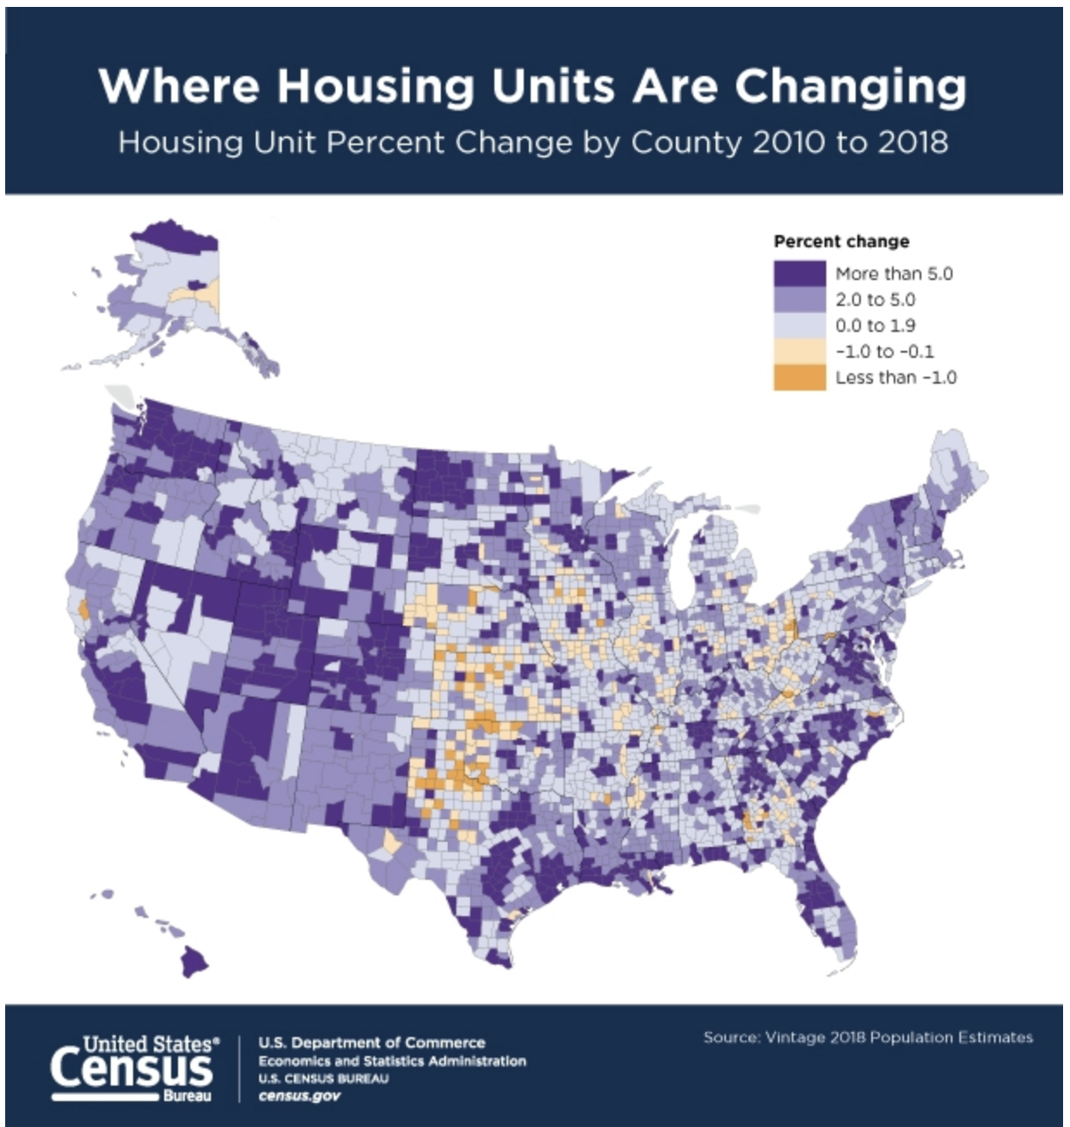
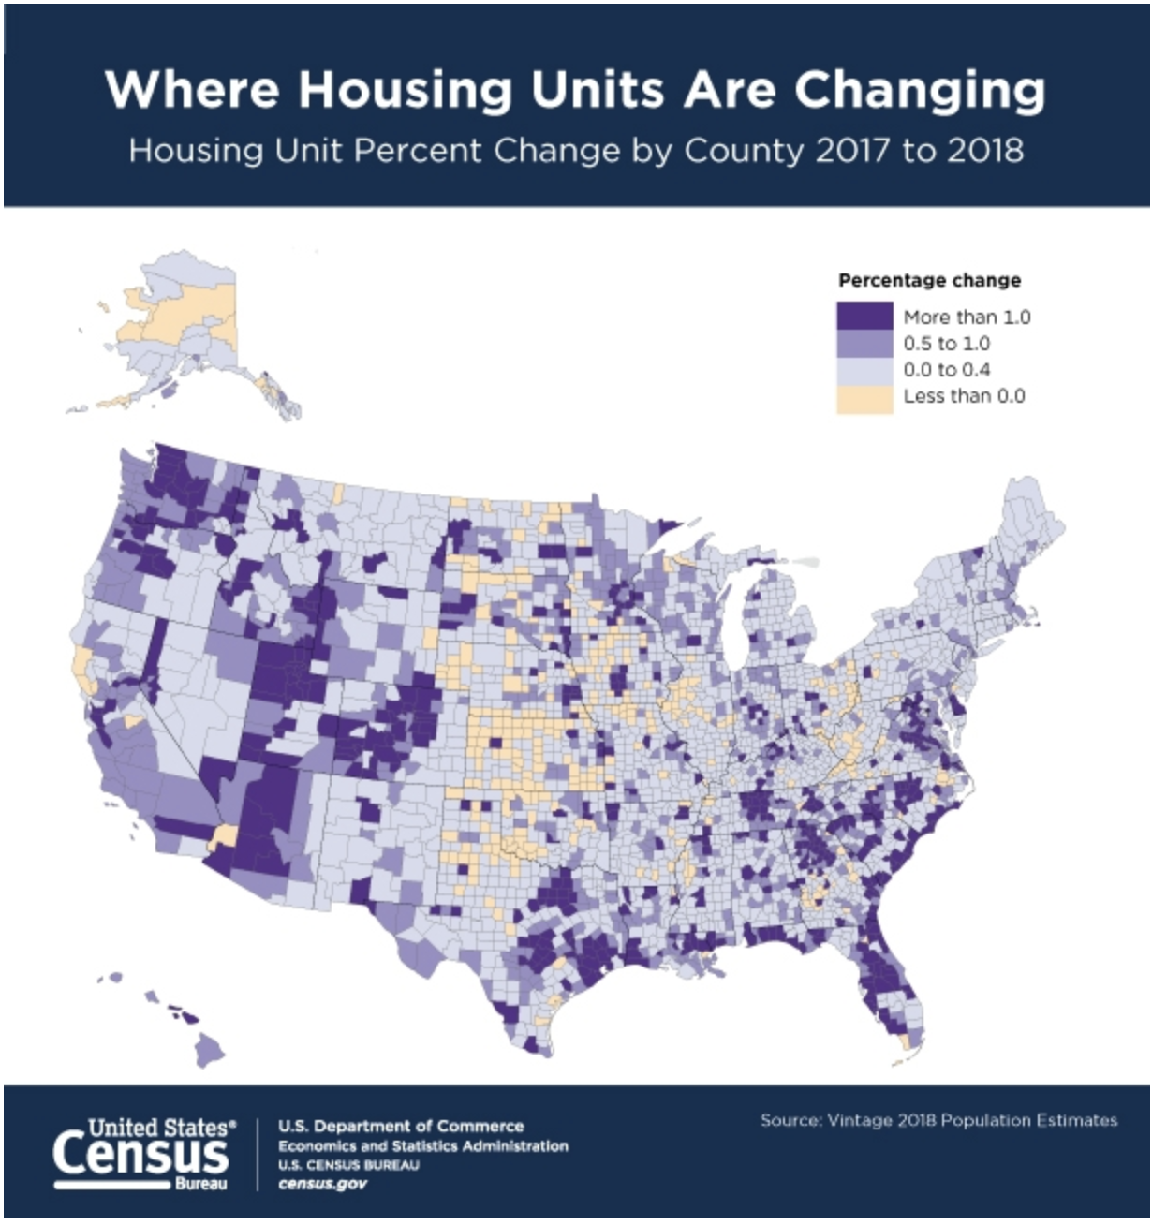
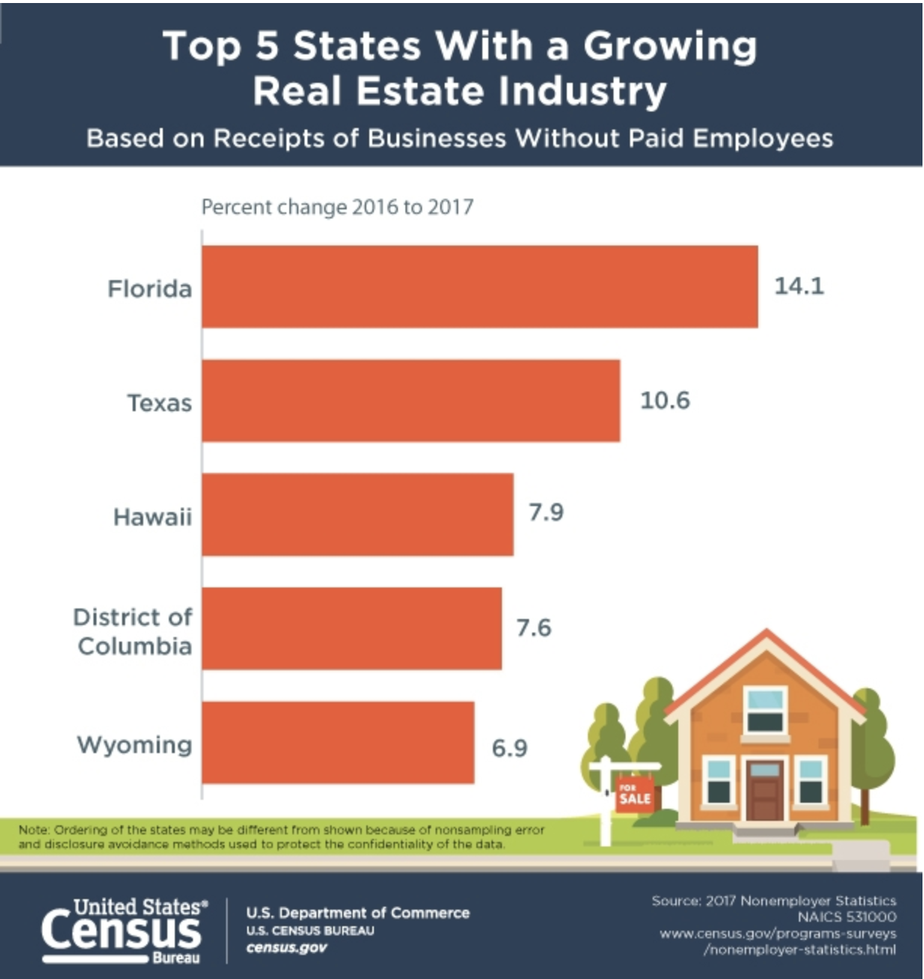
Housing Units
Source: US Census Bureau: https://www.census.gov/library/visualizations/2019/comm/housing-unit-change-2010-2018.html
Source: US Census Bureau: https://www.census.gov/library/visualizations/2019/comm/housing-unit-change-2017-2018.html
Notes:
Jamie
Housing units are increasing in WA, FL, CO, UT

Slide 13
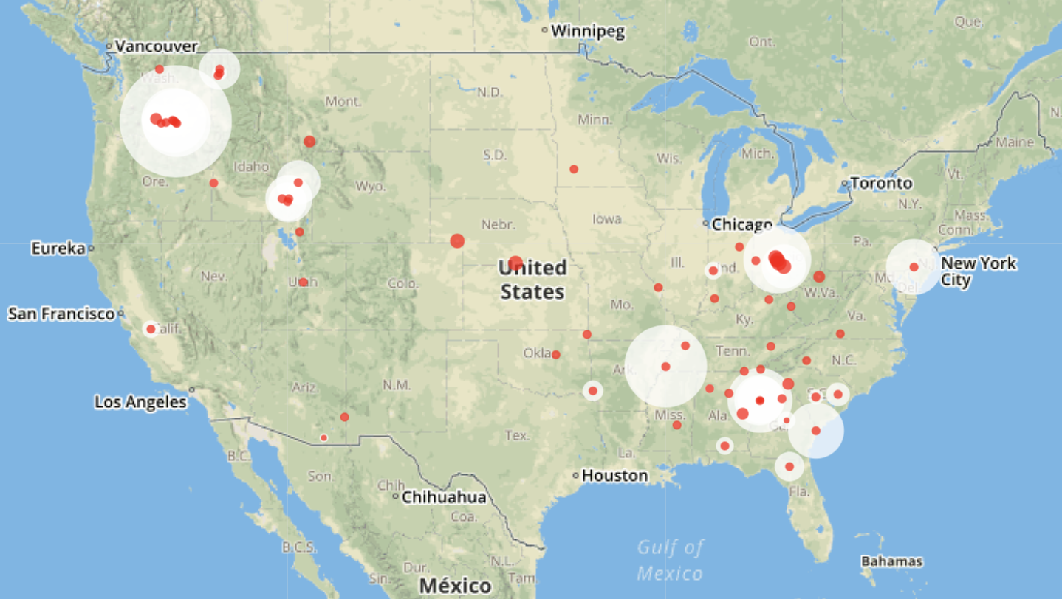
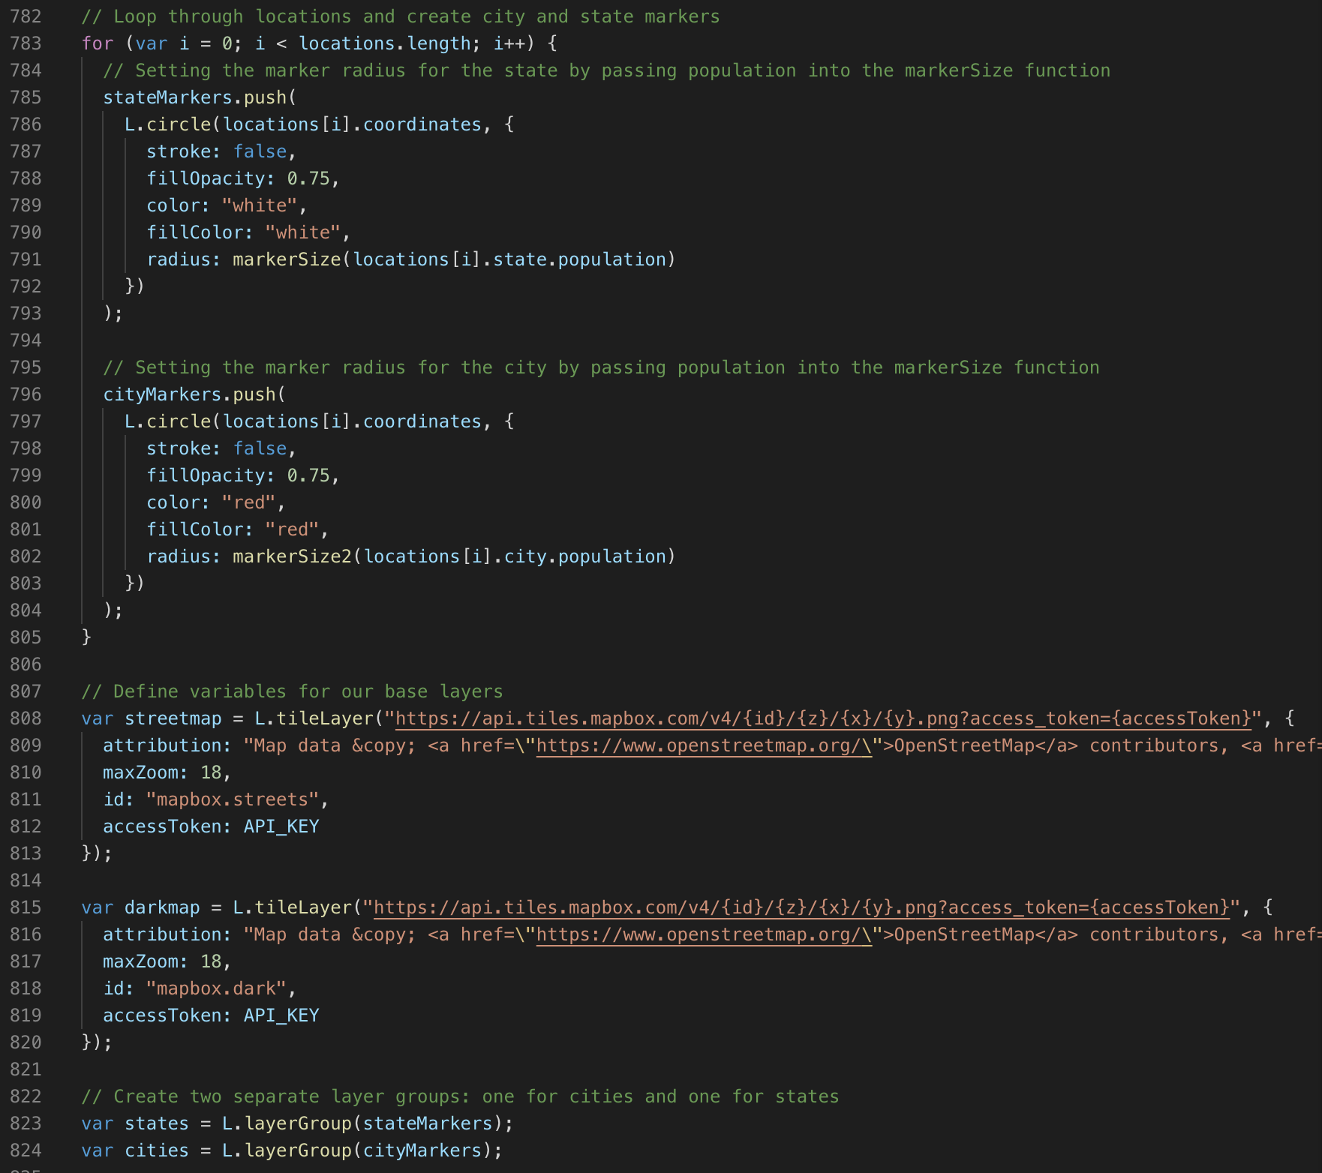
% Change in Per Square Foot Price Year-over-Year
Notes:
Jamie
Washington, Ohio, and Southeast have biggest % increase in per square foot price
Looking at zip code level, we found that these areas have highest percentage increases in per square foot price.
Zip codes with the Highest % change
Columbus OH (38%), Plain City OH (38%), Marysville, OH (36%)
Toppenish WA (24%), Twisp WA (22%) ,Prosser WA (22%)

Slide 14
Conclusion
High Potential Markets
Low Potential Markets
Notes:
Rod
The market to avoid for most investors would be the California market due to its unappealing factors (expensive market and high poverty rate) that have caused it to have the worst growth amongst all cities analyzed
The best market for our investors to invest in would be the Washington and Ohio market due to its high growth potential

